Slide 1

Section: 02 Group: 08

Slide 2




TEAM MEMBERS:
(https://github.com/alekhyajaddu/alexa-project)
Annie Samarpitha Chandolu Alekhya Jaddu
https://github.com/annie0sc https://github.com/alekhyajaddu
Gundu Pooja Sushma Chanati
https://github.com/gundupooja https://github.com/sushmachanati

Slide 3
AGENDA
Introduction
Voice-controlled systems
Alexa Skills Kit (ASK)
How Does It Work?
AWS Lambda
Endpoints
Interaction with Alexa
Amazon Echo
Conclusion
References
Sushma Chanati

Slide 4
INTRODUCTION
Alexa is Amazon's cloud-based voice service platform that powers an entire smart device ecosystem. It enables the customers to interact with more intuitive way using VOICE.
Examples of these skills include the ability to play Music, provide Information, deliver news and sports scores, tell you the weather information.
Alexa is built in the cloud so it is always getting smarter.
Sushma Chanati

Slide 5
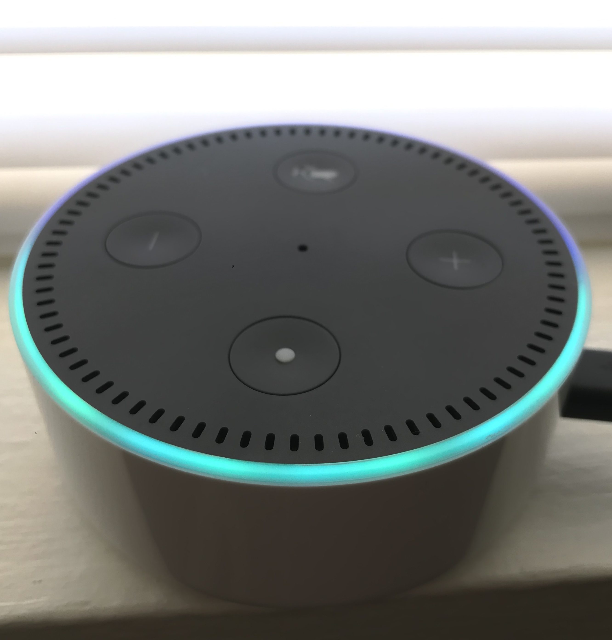
Amazon Alexa
It is a hands-free speaker controlled with your voice.
It has a personal assistant called ALEXA who will perform various tasks
Sushma Chanati

Slide 6
Voice-controlled systems
The past decade has been dominated by touch screen devices, but a new revolution is brewing voice-controlled systems powered by Artificial Intelligence.
Smart' and 'connected' are the two words defining the majority of devices around us today. One of the fastest growing categories with these two features lies with smart speakers.
We are controlling everything via virtual assistants instead through apps.
Sushma Chanati

Slide 7
Alexa Developer Console
Invocation
Intent
Build Model
Endpoints
Important Sources
https://developer.amazon.com
https://aws.amazon.com
Alekhya Jaddu

Slide 8

ALEXA SKILL KIT (ASK)
The Alexa Skills Kit provides Self Service APIs and tools that you can use to build Alexa skills
Amazon allow developers to use to build skills for Alexa using Alexa Skill Set
Alekhya Jaddu

Slide 9
ALEXA SKILLs
CUSTOM SKILLS
Build a skill with a custom Interaction Model. This is called Custom Skill.
Customer needs to remember the interaction name or Invocation phrase
Alekhya Jaddu

Slide 10
Alexa Speech Detection
Alexa, run event application.
Wake Word
Request
Alekhya Jaddu

Slide 11
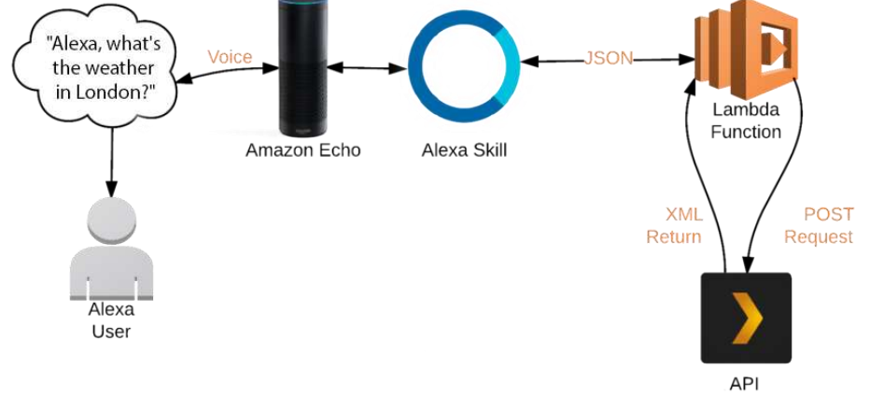
How does it work?
Annie Chandolu

Slide 12
AWS LAMBDA
AWS Lambda is an event-driven, server-less computing platform provided by Amazon as a part of Amazon Web Services.
The purpose of Lambda, is to simplify building smaller, on-demand applications that are responsive to events and new information.
AWS Lambda can also be used to automatically provision back-end services triggered by custom HTTP requests.
AWS Lambda supports code written in several languages, including Node.js, Java, and Python.
Annie Chandolu

Slide 13
Endpoints
Endpoint links the intents and utterances that you have set up in the Amazon Developer console to the lambda function which will control how your skill responds to that intent from the user.
At the top of the page you will now have an ARN (Application Reference Number). Copy this ARN.
Head back to the Alexa Developer Console. Under the Endpoints menu, paste in the ARN next to Default region.
Save endpoints.
Annie Chandolu

Slide 14
Interaction with Alexa
After connecting, Alexa skill to a Lambda function, Lambda executes it in response to Alexa voice interactions.
Alexa communicates with your service via a request-response mechanism using HTTP over TLS.
When a user interacts with an Alexa skill, your service receives a request containing a JSON body.
The request body contains the parameters necessary for the service to perform its logic and generate a JSON-formatted response.
Annie Chandolu

Slide 15
Amazon Echo
Amazon Echo smart speakers developed by Amazon Lab126.
It is capable of voice interaction, music playback, providing weather, traffic, sports, and other real-time information, such as news.
Alexa can also control several smart devices using itself as a home automation system. Users are able to extend the Alexa capabilities by installing "skills“.
Amazon had over 90,000 functions ("skills") available for users to download on their Alexa-enabled devices.
Pooja Gundu

Slide 16
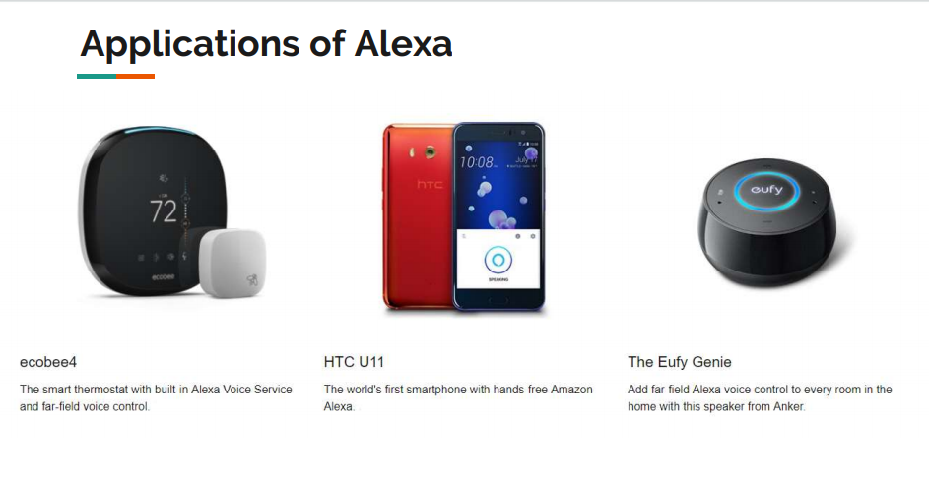
Applications of Alexa
Pooja Gundu

Slide 17
CONCLUSION
Amazon Echo is a big step forward when it comes to voice controlled technology.
As the technology continues to improve you can do a lot of things with Alexa
The main focus for Amazon in the near Future is on making Alexa's capabilities, suggestions and language more natural and tailored to us. That could mean infinitely smarter conversational skills, personalized suggestions
Pooja Gundu

Slide 18
REFERENCES
https://github.com/profcase/skill-bearcat-buddy
https://github.com/blondiebits/code-in-5
https://developer.amazon.com/alexa
https://aws.amazon.com
https://en.wikipedia.org/wiki/Amazon_Alexa
https://www.youtube.com/watch?v=d12DhlFVERc
https://www.youtube.com/watch?v=5zsKViLKhi0
Pooja Gundu

Slide 19


